Slide 1
What is Big Data
Big data is a field that treats ways to analyze, systematically extract information from, or otherwise deal with data sets that are too large or complex to be dealt with by traditional data-processing application software. Wikipedia

Slide 2
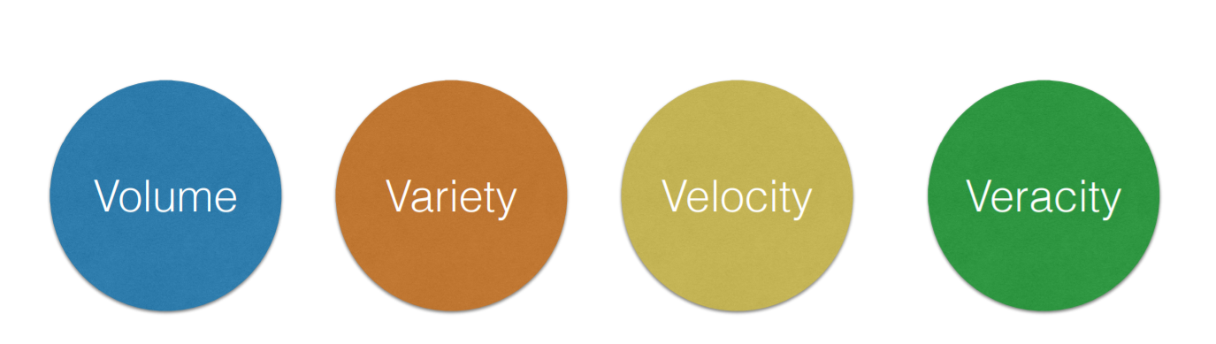
3V’s of BIG DATA
VOLUME: Refers to the volume of the data (SIZE OF THE DATA)
VARIETY: Type of the data (structured, unstructured or semi structured)
Structured: tables with columns (customer table)
Unstructured: social media data, email
VELOCITY: Time taken to process the data
VERACITY: Quality of the data

Slide 3
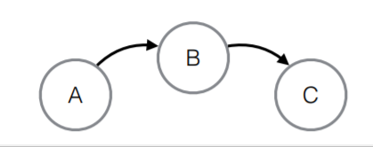
BIG DATA EXAMPLES
Amazon, Netflix and Spotify – Recommendation Engine
Uber and Hailo – Uses GeoData and Sensor Data
(Fastest Route has to be updated)
(Closest taxi has to be found)
Google and Apple Siri processes voice data and makes decision
Tesla AutoPilot – sensor data and image processing
( route, traffic and speed analysis)
NYSE & Bloomberg: Analyses large volume of trading data
Google Analytics : Log Data
Intelligence Agencies : Graph Data

Slide 4
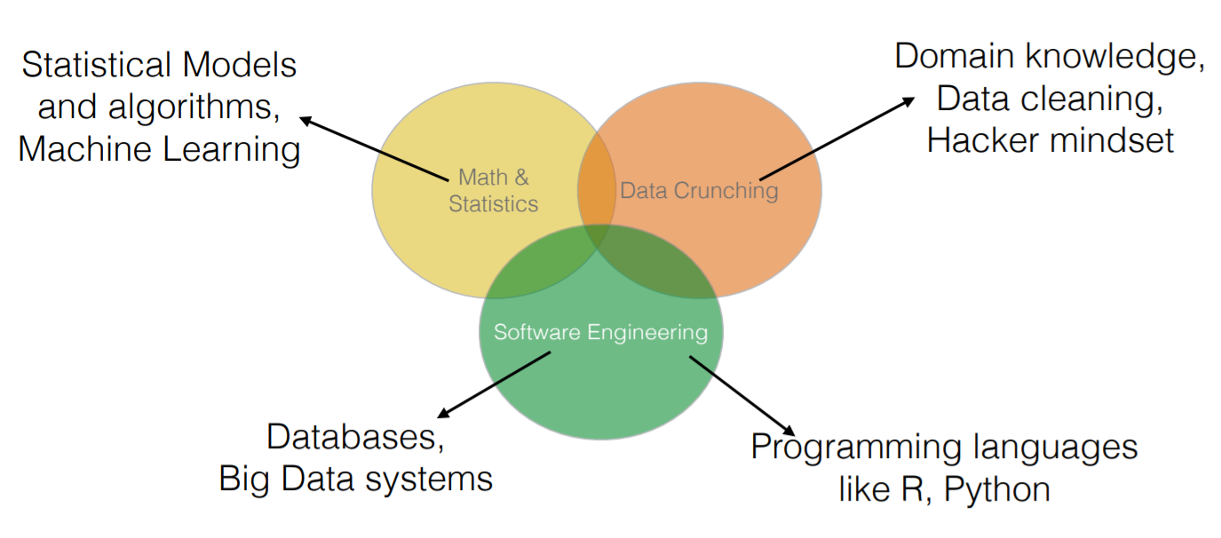
Data Scientist

Slide 5
What is Hadoop?
Hadoop is software to reliable and scalable store and process Big Data
• Runs on commodity hardware
(is a device or device component that is relatively inexpensive, widely available and more or less interchangeable with other hardware of its type.)
• Low cost per GB
• Ability to store Petabytes of data in a single cluster
• Hadoop was invented at Yahoo! and inspired by Google’s GFS (Google
File System) and Google’s MapReduce papers
Byte-8 bits
Kilo Byte /1024 bytes
Mega Byte /1024 KB
Giga Byte /1024 MB
Tera Byte/1024 GB
Peta Byte /1024 TB
Exa Byte /1024 PB
Zetta Byte /1024 EB
Yotta Byte /1024 ZB
• It’s open source, maintained under the Apache umbrella

Slide 6
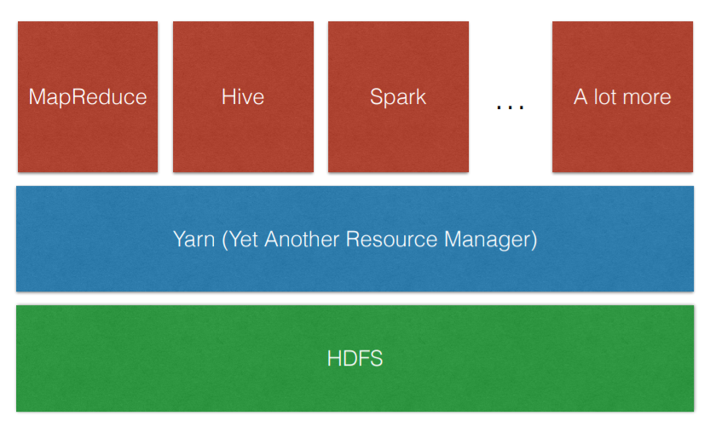
ARCHITECTURE
HDFS, the Hadoop Distributed File System, stores the data within cluster
Yarn is the interface you submit your applications to, it manages cluster resources like CPU and MEM for you
Applications can be submitted using any of the processing engines built on top of Hadoop
One of the simplest distributed application you can write is counting the words of a text file stored in HDFS using the MapReduce framework

Slide 7
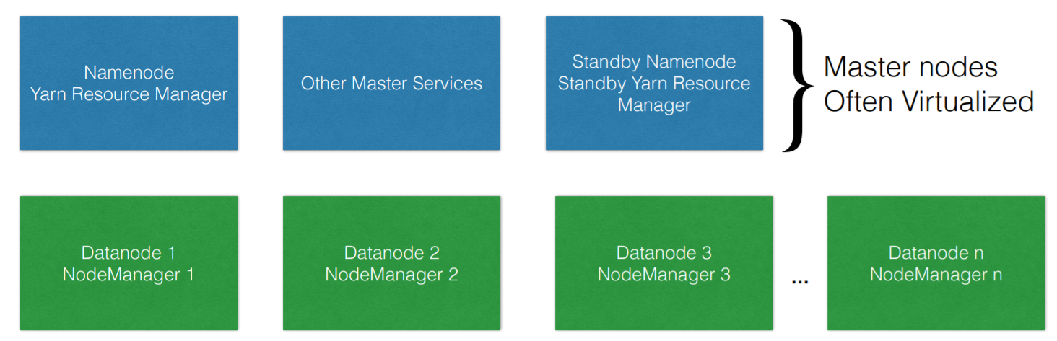
What is Hadoop?
Hadoop is a distributed System
The data nodes / worker nodes (in green) can scale horizontally
Data will be stored in the green node and process will run on it
Services used to process data is called as datanode service
Services responsible to run applications on the node is called nodemanager
Standby node is used in case Namenode fails

Slide 8
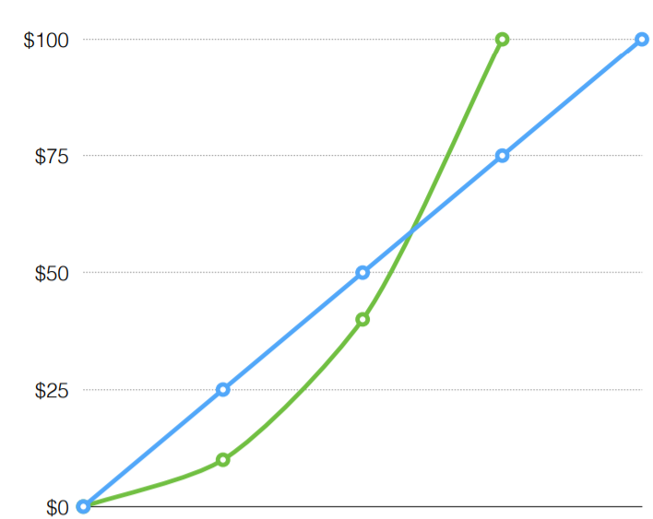
Let’s compare the cost per gigabyte of a traditional database and Hadoop
Traditional databases (in green) that cannot scale horizontally will initially have a lower cost per GB
The moment you need a lot of storage & processing, by horizontally scaling instead of putting more memory and cpu, you will have a cost benefit
Price
storage

Slide 9
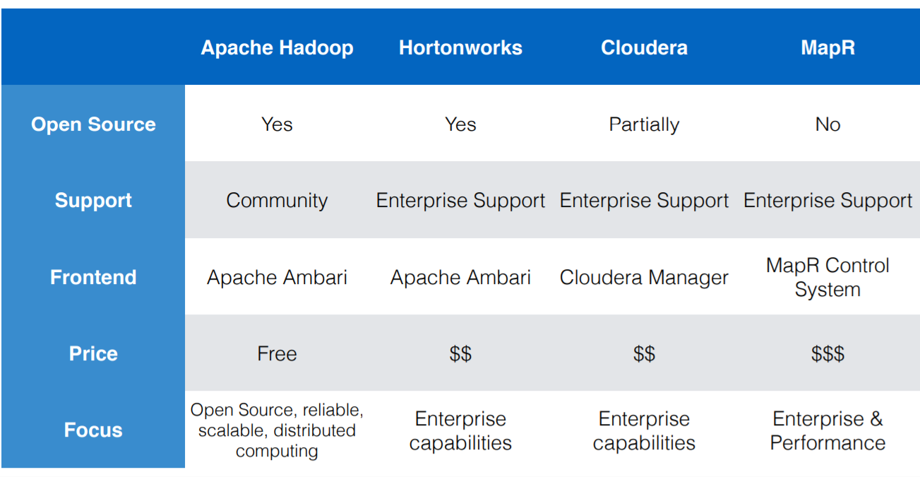
Hadoop Distributions

Slide 10
